Slide 1


SUPPLY CHAIN MANAGEMENT
Supply Chain Dashboard
KPI & Performance Analysis
Data-driven insights from 12,000 order records across 20 warehouses and 5 global regions
Presented by Group 4
Omkar Chaudhari
Dhairya Yadav
Uma Rathod
Mrudula Mahadik
Meghana H.N.
Sowmya V.

Slide 2
1
Project Summary
2
KPI Overview — Sales & Profitability
3
KPI Overview — Delivery & Fulfillment
AGENDA
What We'll
Cover Today
4
Orders by Ship Mode & Top Categories
5
Forecast Accuracy & Delay Trends
6
Key Takeaways & Recommendations

Slide 3




Project Summary
A brief overview of the project's objectives and business impact.
Objective
Analyze end-to-end supply chain performance — sales, delivery, fulfillment, and demand planning — using 12,000 order records to surface actionable insights.
Dataset Snapshot
12,000
Scope
Order Lines Analyzed
Covers order and revenue trends, on-time delivery, backorders, forecast accuracy, and lead times across 20 warehouses, 5 regions, and 5 product categories.
20
Approach
Warehouses
KPIs were calculated directly from transactional order data to reflect true operational performance rather than estimates.
5
Global Regions
Business Impact
5
Findings highlight where delivery reliability, inventory planning, and shipping-mode mix can be improved to protect margin and customer satisfaction.
Product Categories

Slide 4



KEY PERFORMANCE INDICATORS
KPI Overview — Sales & Profitability
Core order volume and financial performance metrics.
12,000
Total Orders
Total number of order lines processed across all warehouses, reflecting overall order volume for the period.
$193.99M
Total Revenue
Total sales value generated from all orders, calculated as order quantity multiplied by unit price.
$68.54M
Gross Profit
Revenue remaining after cost of goods sold and shipping costs — a 35.3% margin on total revenue.
66.0%
On-Time Delivery
Share of orders delivered on or before the promised delivery date — a core measure of delivery reliability.

Slide 5




KPI Overview — Delivery & Fulfillment
Metrics tracking delivery speed, reliability, and planning accuracy.
1.46 days
Avg. Delay Days
Average number of days orders are delivered late beyond the promised delivery date, across all shipments.
3.1%
Backorder Rate
Share of ordered units that could not be shipped immediately, indicating gaps in stock availability.
96.9%
Forecast Accuracy
How closely shipped quantities matched ordered quantities — a proxy for demand planning reliability.
4.93 days
Avg. Lead Time
Average time between order placement and the order leaving the warehouse (order processing time).

Slide 6
VISUAL ANALYSIS
Orders by Ship Mode & Top Categories
How order volume splits by shipping mode and which categories drive revenue
Orders by Ship Mode
Top Categories by Revenue
Road leads with 4,643 orders (38.7%), the dominant mode.
Air follows at 30.0%, used for faster, time-sensitive shipments.
Sea and Same-day together carry under 15% of orders, signalling room to rebalance cost vs. speed.
Electronics generates $152.66M, about 78.7% of total revenue.
Home & Kitchen is a distant second at $26.90M.
Food & Beverage and Healthcare together contribute under 2.5% of revenue.

Slide 7
Forecast Accuracy & Delay Days Trend
How closely shipments matched demand, and how delivery delays moved over time
Forecast Accuracy % by Month
Average Delay Days by Month
Forecast accuracy stays high, ranging from 96.1% to 97.6%.
Best alignment was in Feb; weakest in Apr, still above 96%.
Consistently strong accuracy suggests demand planning is not the main driver of delivery issues.
Delay days hover close to 1.3–1.7 days all year, with Aug the worst month.
Jun recorded the shortest average delay, but the gap between months is small.
Delays are steady rather than seasonal, again pointing to a process-level fix.

Slide 8
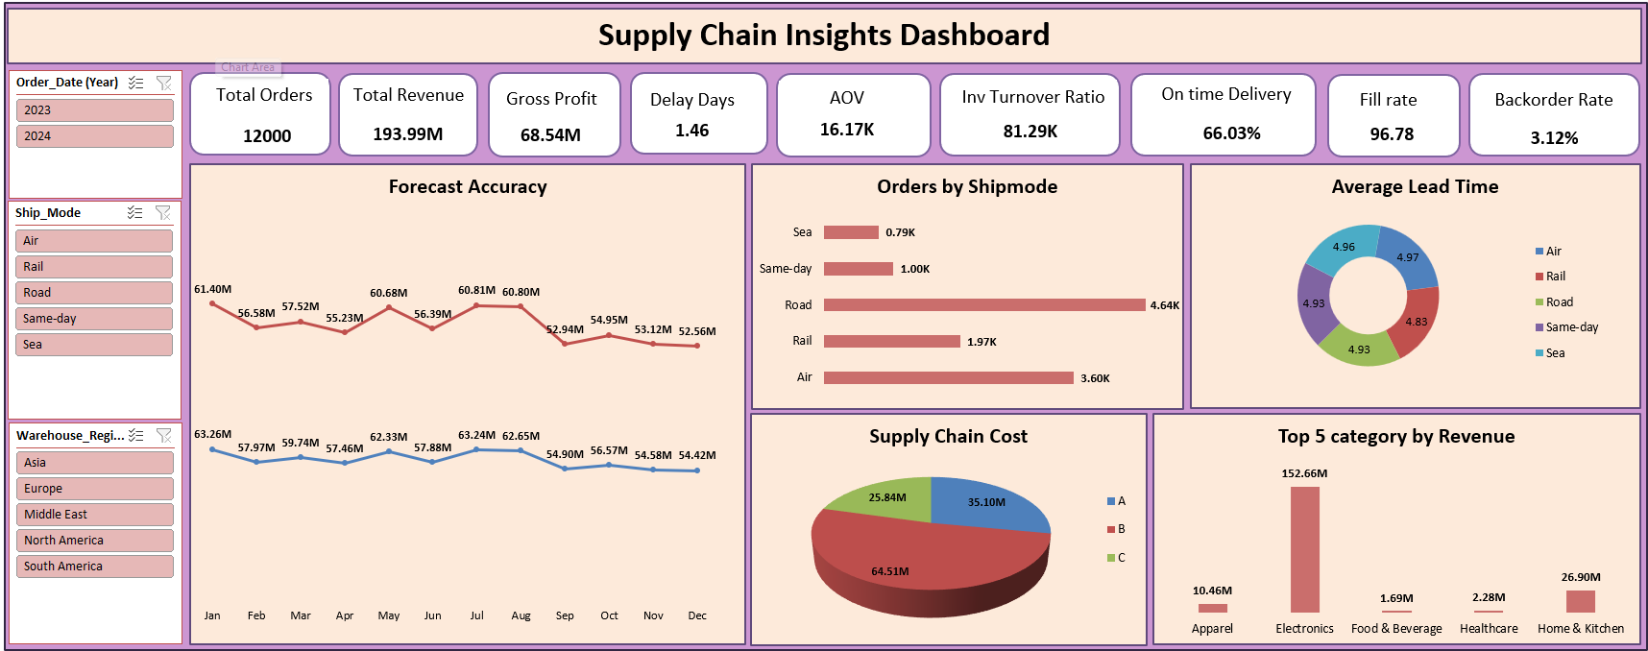
EXCEL SUPPLY CHAIN DASHBOARD

Slide 9
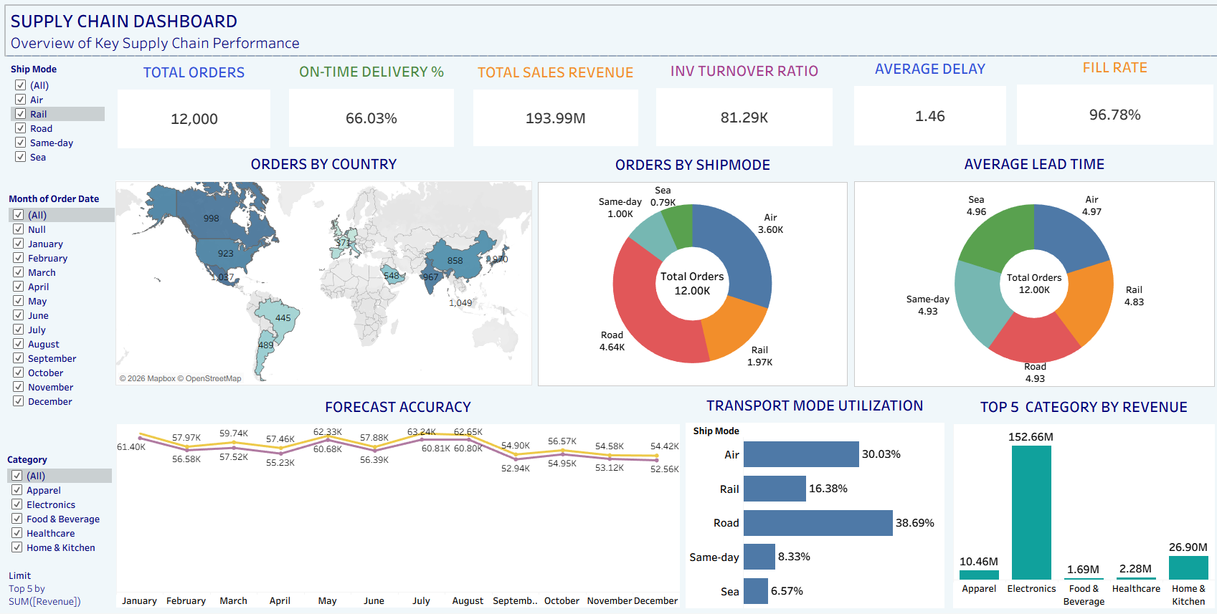
TABLEAU SUPPLY CHAIN DASHBOARD

Slide 10
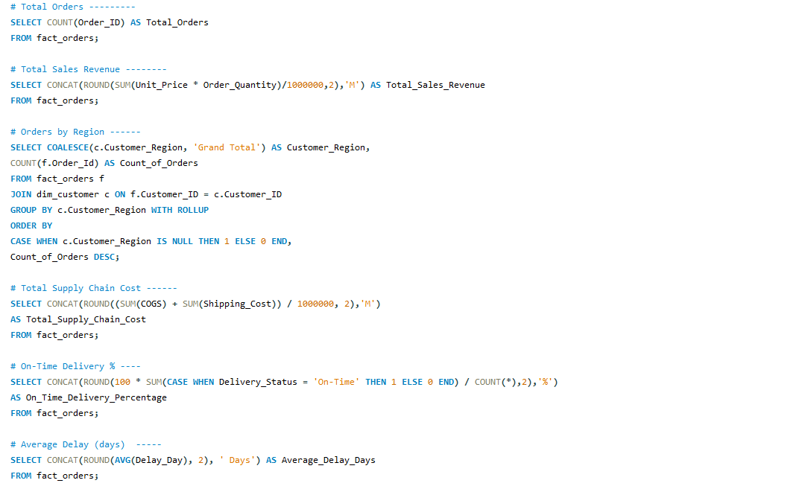
SQL QUERIES SUPPLY CHAIN DASHBOARD

Slide 11
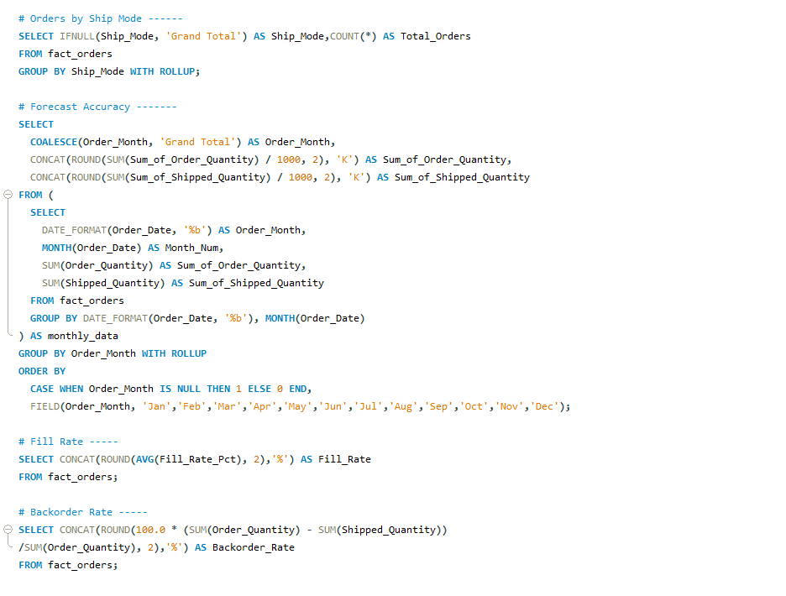

Slide 12
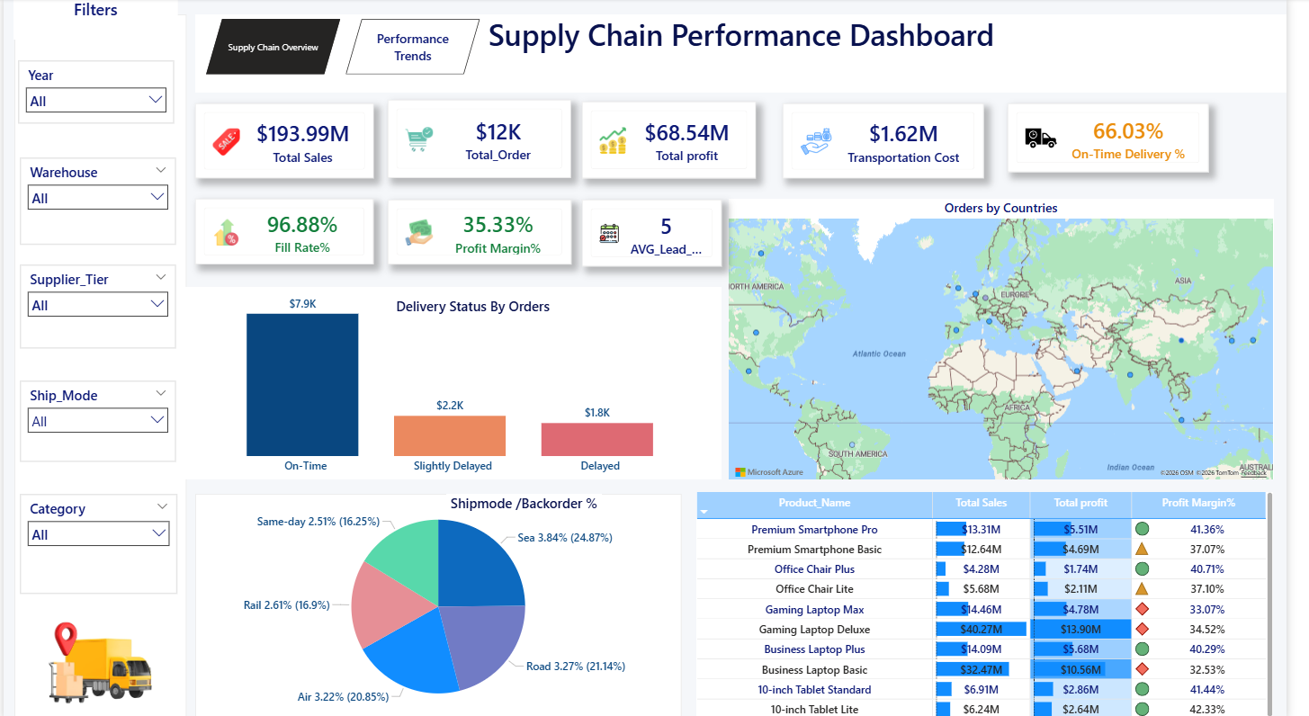
POWER BI SUPPLY CHAIN DASHBOARD

Slide 13
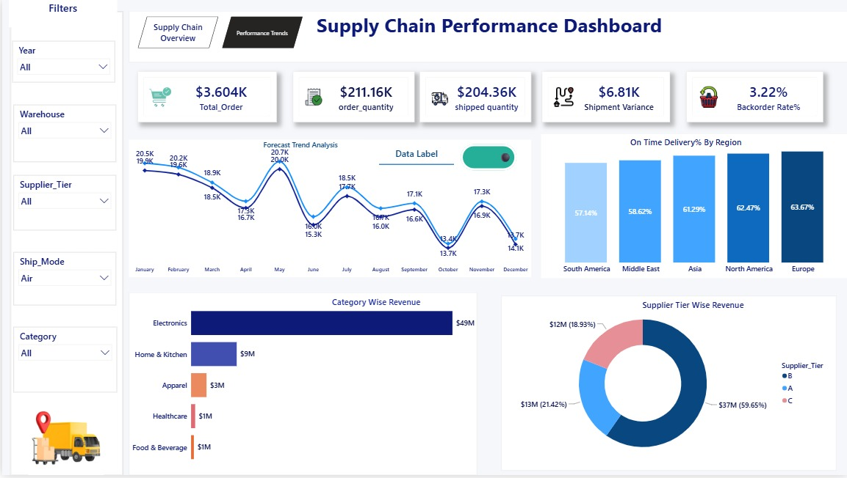

Slide 14


Key Takeaways
The big picture, in five simple points.
Revenue is concentrated
Electronics alone makes up about 79% of revenue — other categories need to grow.
Deliveries run late
Only 66% of orders arrive on time, with an average delay of 1.46 days per order.
Some orders go unfulfilled
3.1% of ordered units are backordered — stock levels need tightening.
Forecasting is solid
96.9% forecast accuracy shows demand planning is not the problem.
Shipping mode is unbalanced
Road and Air carry most orders — shifting some to Sea could cut cost.
Bottom line: planning is strong, but delivery speed and revenue mix are the two things to fix next.

Slide 15

THANK YOU

